Slide 1

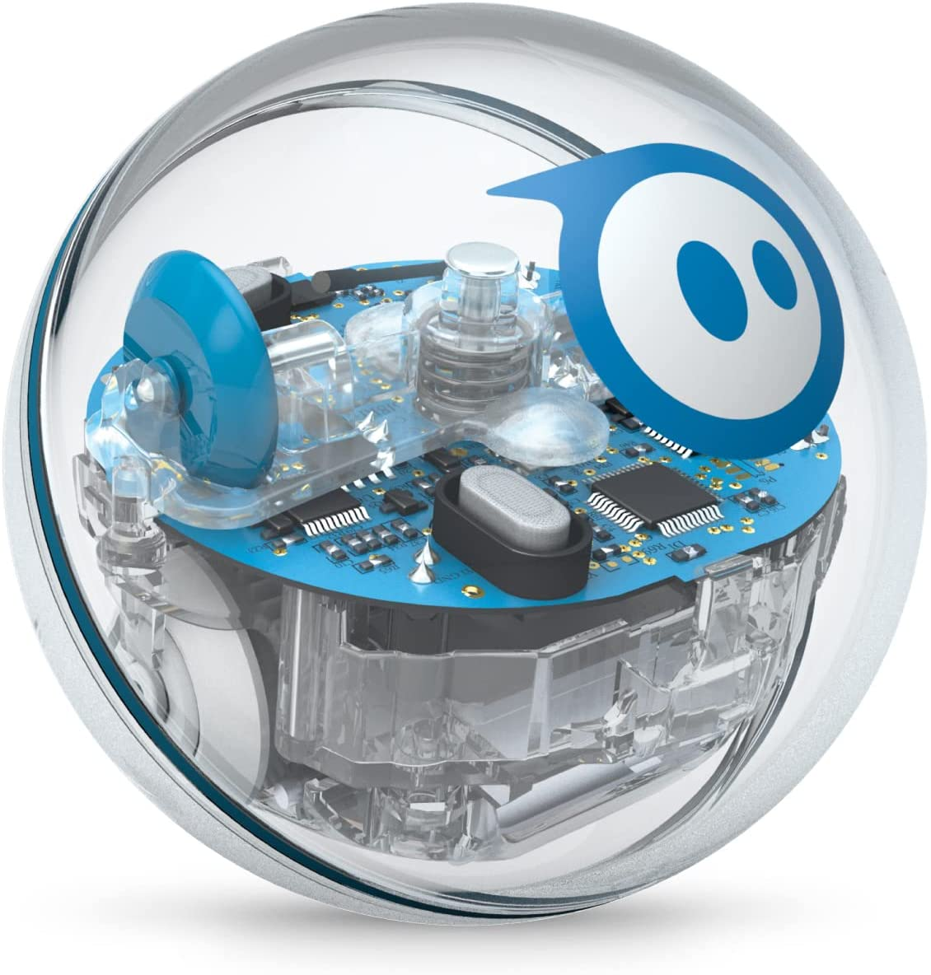
Sprint 4 - Presentations
Pat Frohn, Brandon Valentine, Madison Kapuscinski

Slide 2
Challenges We Faced
After completing all three sprints, the most common challenge would be the uneven floor and getting the proper angles for the robot. The inconsistency from the floor altered the projection of the robot multiple times, and this caused lots of frustration. Angles were also an issue, because if you were off by the smallest degree, it would throw off the trajectory of the robot.
These challenges helped us improve our robot and gave us the opportunity to fix our mistakes.

Slide 3
Roles of each Member
Pat Frohn - Programmer, (Block Code, Sensor Data, Robot Testing)
Brandon Valentine - Information Recorder, (SDD, Gantt Chart, Test Table)
Madison Kapuscinski - Plan Designer,(Algorithm, Flowchart, Robot Video)

Slide 4
What we learned about Software Engineering
We learned what was needed to work effectively as a group.
Communication- We learned that good communications skills are important to effectively working together and finding time to meet up.
Splitting Work-We learned the importance of splitting the work amongst the group in order to complete the project in a timely fashion and be understanding of what people had time for in their schedule.
Flexibility- Everyone in the group has a different schedule so we had to be understanding and be flexible in order to meet up and get the work done.
Patience- Sometimes the testing did not go as expected so we had to be patient and make the necessary adjustments to complete the project.

Slide 5
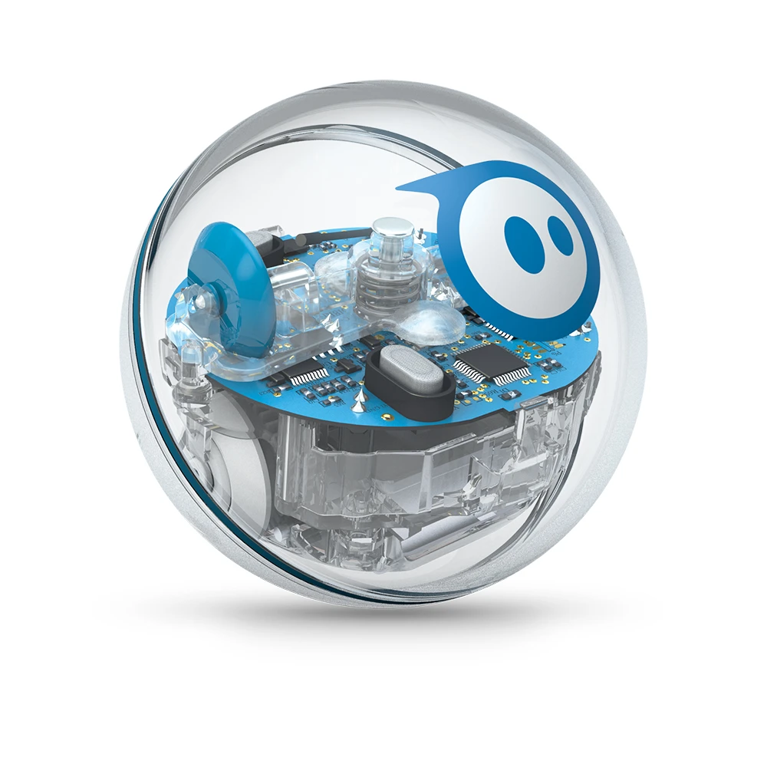
What would you do differently?
After doing this project, I feel that the way we approached and executed the tasks were very successful. There was not much that we could have done differently, other than possibly meeting more frequently outside of class to discuss the project, since everyone has a different schedule, it was tricky to assign a time to meet and work on the project.

Slide 6
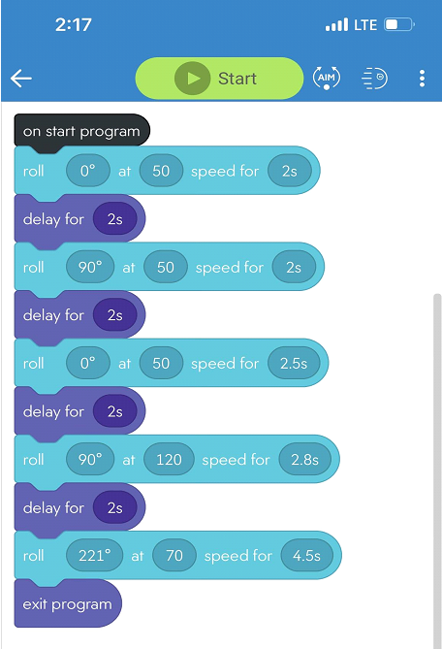
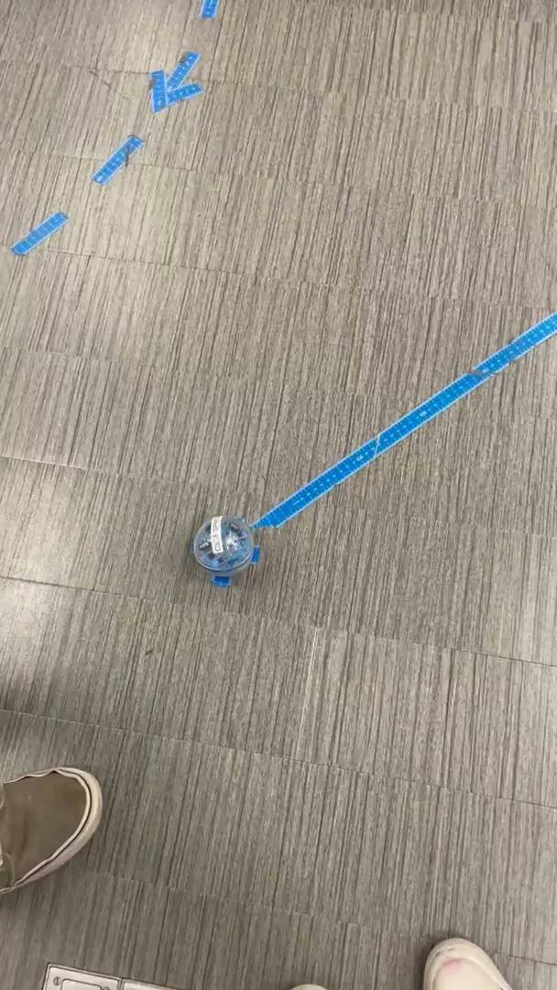
Block Code and Video for Sprint 3
Here is the block code for Sprint 3 - Agility —------->

